Slide 1
GA in New Zealand:
Not sure we are winning.
CAA all good except medical.
AOPA NZ in good shape.
What would help us.
Harmony – Internationally.

Slide 3
Webcam NZ weather…..
No shortage of camera’s.
Needed to bring together.
App and link on website.
Much appreciated by members and others.

Slide 4
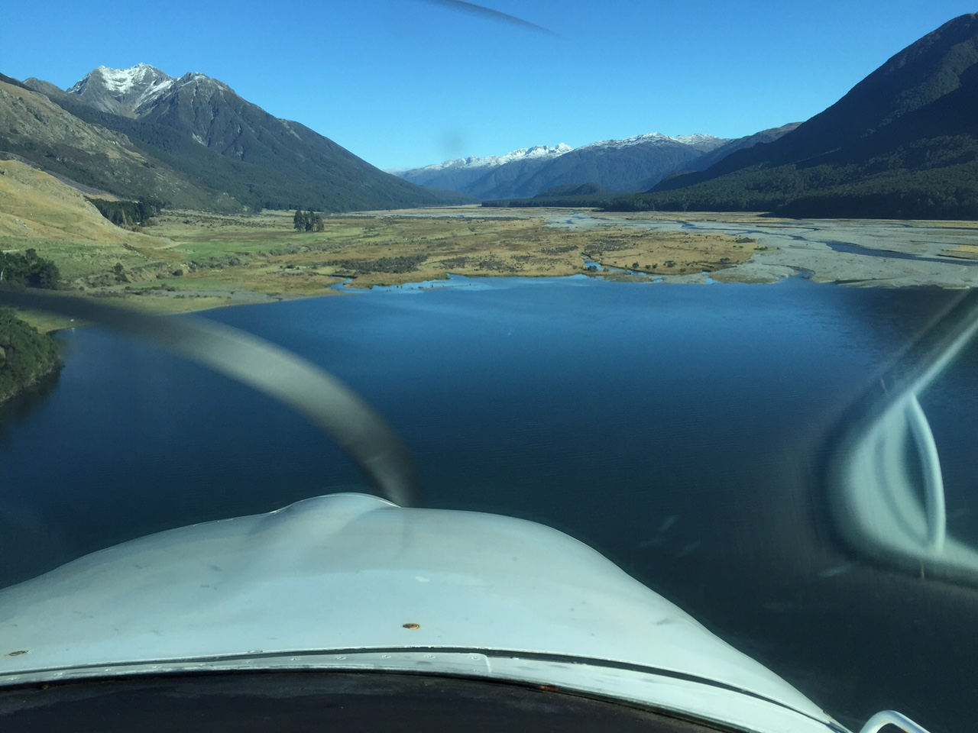

Slide 5
DATA
Safety.
Loss of control.
Medical issues.
No shortage – how do we mine?

Slide 7
Better Links with region.
Web based.
Shared articles.
More emphasis on welcome.
‘How to fly in NZ’.

Slide 8
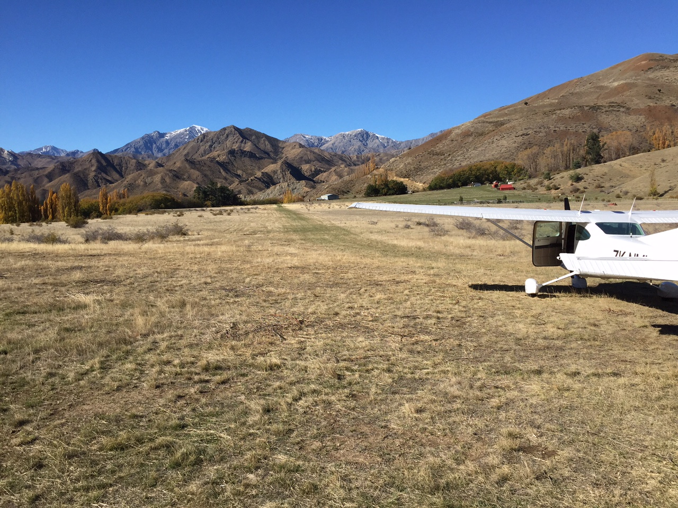

Slide 9
Flight Safety Video – series.
Mountain flying.
Back country flying.
Weather.
Ipad augmentation.
Plus…….. Free from website.

Slide 10
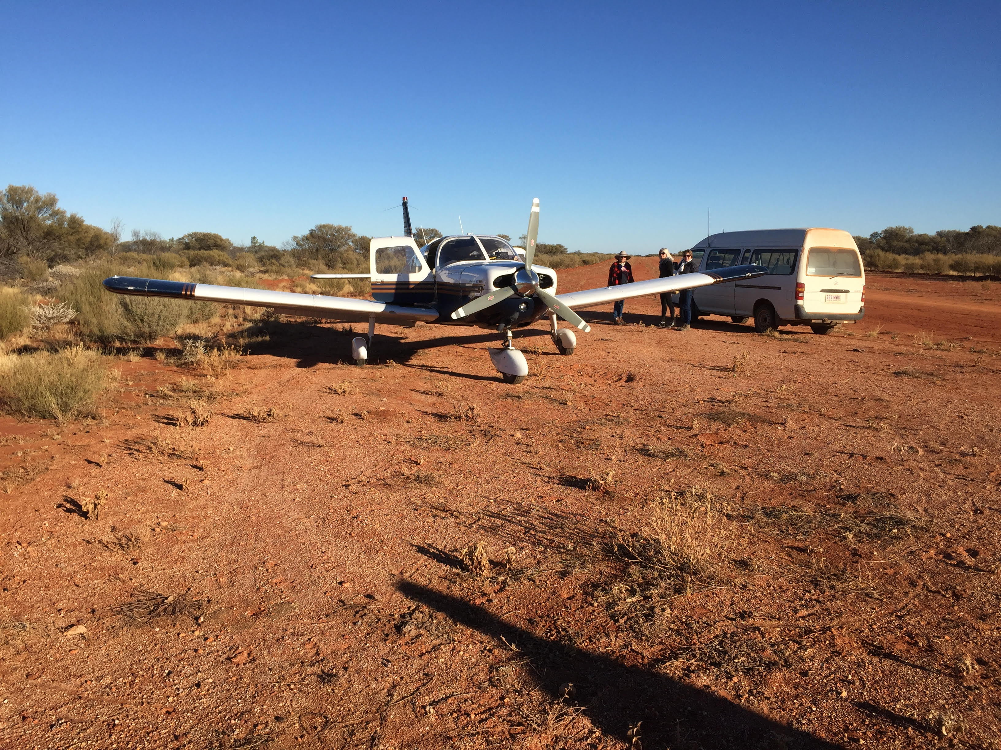

Slide 11
Medical Issues.
Well covered.
Individual countries need to move forward.
AOPA need to push for ‘bilateral agreements’.
ICAO will fall into line sometime.
NZ well on way to modernising standards.

